Slide 1
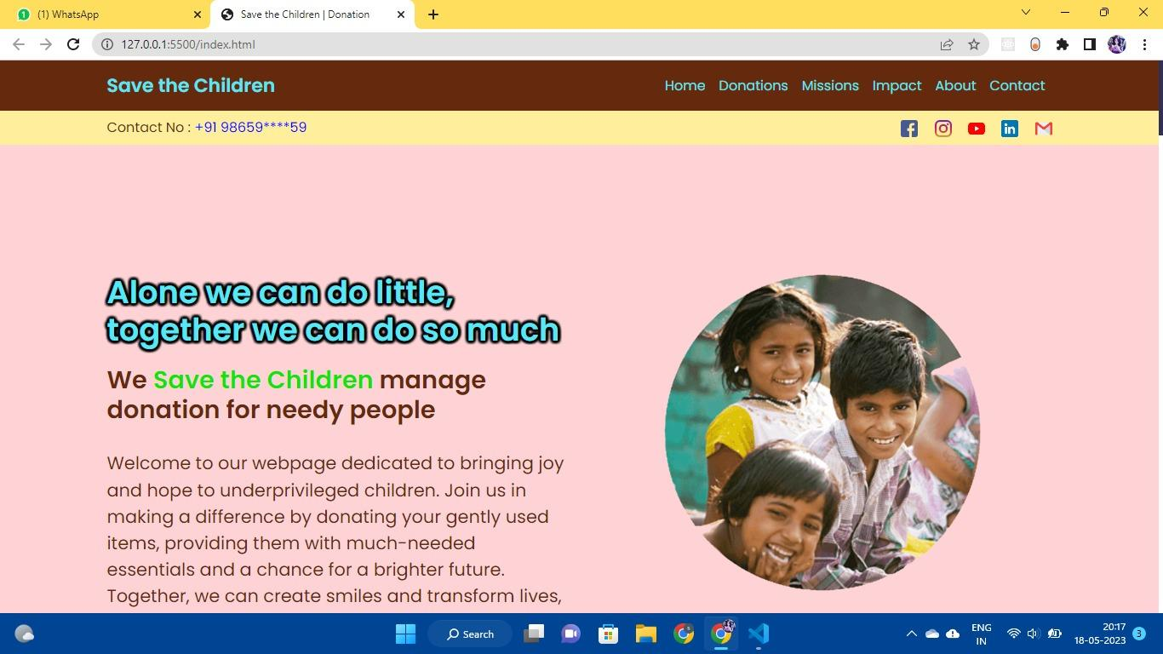
INNOVATRIX - HACKATHON WEB PROJ
A website to direct donations for helping out underprivileged children, built completely using HTML, CSS and Javascript. Facility for all kinds of donations have been included.
Project by :-
Raunak Saha Fouzder
Sreoshee Dutta

